Slide 1
OOSE 課輔
2019/09/11

Slide 2
加分
個人:
自願回答問題 +10
群體:
Bonus Time 全對+50，半對+30
登記方式:
手寫 班級 姓名 學號 給助教

Slide 3
MVC
What is “MVC” for?
Model, View and Controller
What is the most important one in MVC?
Model, so view and controller can be combined together

Slide 4
The Model
The Model is the part that does the work--it models the actual problem being solved
The Model should be independent of both the Controller and the View
But it provides services (methods) for them to use
Independence gives flexibility, robustness

Slide 5
Pattern
Why do we need design patterns?
It is reusable and provides solutions to deal with the problems.
What is the character of design patterns in MVC?
Model, model is the expert to solve the problems.

Slide 6
Gang of Four Pattern
What are the categories of patterns?
Creational, Structural, Behavioral
Creational Patterns focus on creation (creating something).
Structural Patterns compose complex structures.
Behavioral Patterns negotiate the responsibilities between objects.

Slide 7
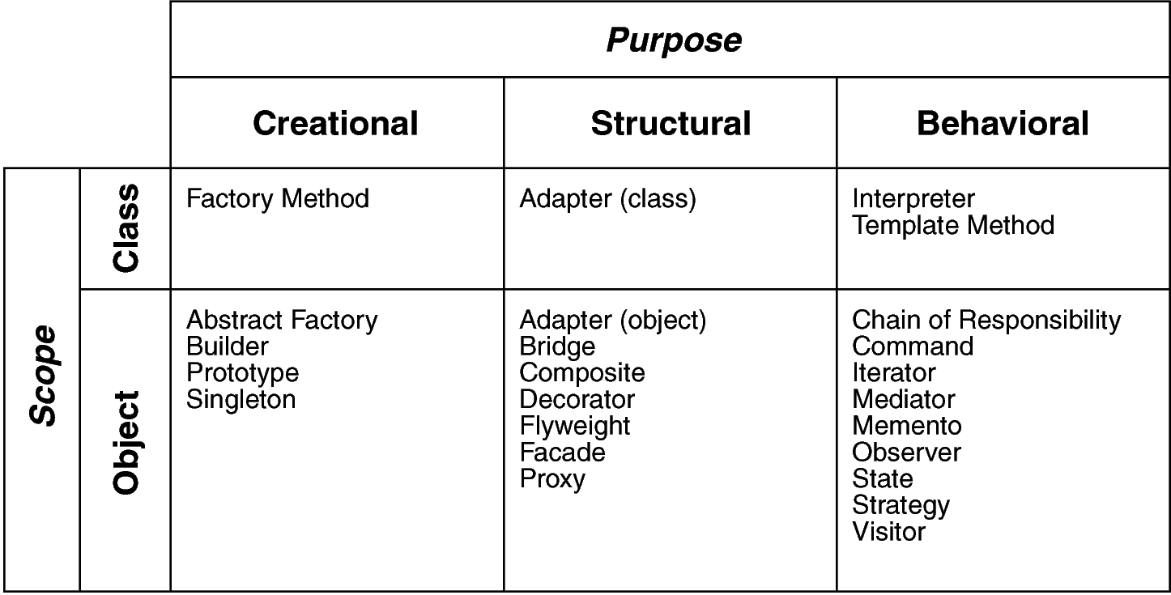
Design Space for GoF Patterns
Purpose: reflects what a pattern does
Scope: domain over which a pattern applies

Slide 8
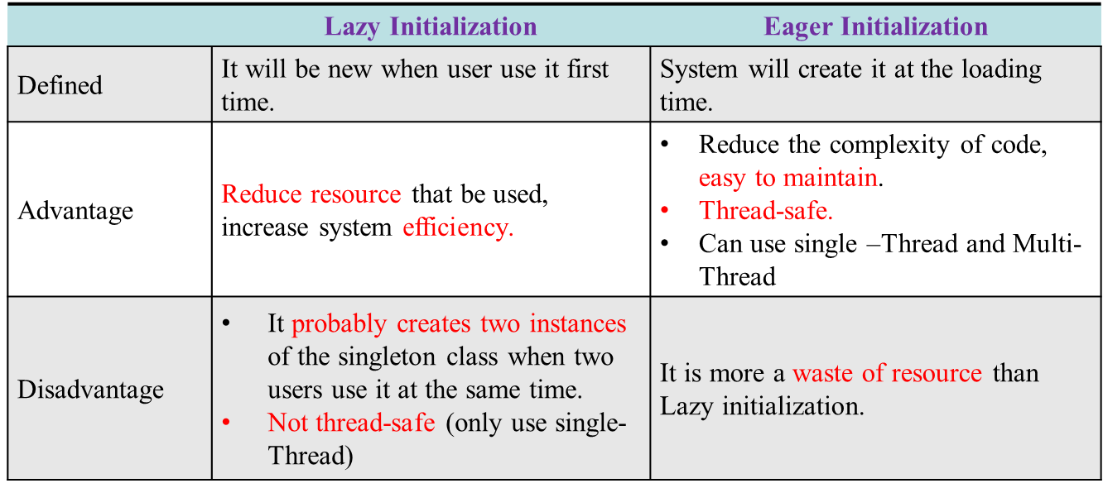
Singleton
Ensure a class only has one instance, and provide a global point of access to it.

Slide 9
Synchronize
public class Singleton {
private static Singleton instance = null;
private Singleton(){}
synchronized static public Singleton getInstance() {
if (instance == null) {
instance = new Singleton();
}
return instance;
}
}

Slide 10
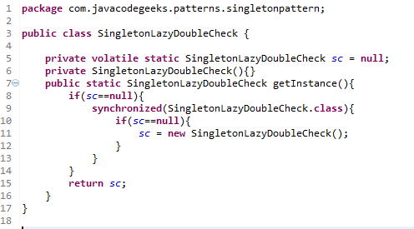
Solution: Double-checked-locking
Client call instance method and method will lock the instance at first time

Slide 11
Example
Train Ticket
The seat cannot be sold to two or more people.
So?

Slide 12
Software Quality Assurance
What is “SQA”?
Software Quality Assurance
Talking about the Reliability and Availability, which one is more important?
Reliability
Why do we need “SQA”?
Hint: subjective and objective

Slide 13
Requirements Metrics
Requirements Unambiguity Q1 =
#of uniquely interpreted requirements
#of requirements
Requirements Completeness Q2 =
#of unique functions
#of combinations of states and stimuli

Slide 14
Requirements Metrics
Requirements Correctness Q3 =
#of validated correct requirements
#of requirements
Requirements Consistency Q4 =
#of non-conflicting requirements
#of requirements

Slide 15
Fan-In & Fan-Out
M1
M2
M1
M2
M3
M3
M4
M4
M13
M13
DBMgr
GUI
M5
M5
M12
M12
M6
M6
M11
M11
M9
M9
M10
M8
M10
M7
M8
M7
Fan-out
Fan-in

Slide 16
Fan-In & Fan-Out
M1
M2
M3
M4
M13
What does Fan-in mean?
High coupling
DB Mgr. has many requests from others.
What does Fan-out mean?
GUI depends others to complete itself, so it is hard to reuse.
DBMgr
M5
M12
M6
M11
M9
M10
M8
M7
M1
M2
M3
M4
M13
GUI
M5
M12
M6
M11
M9
M10
M8
M7

Slide 17
Modularity
Modularity – Measured by cohesion and coupling metrics.
Modularity = (a * Cohesion + b * Coupling)/(a + b), where a and b are weights on cohesion and coupling.

Slide 18
Module Design Complexity mdc
The number of integration tests required to integrate a module with its subordinate modules.
It is the number of decisions to call a subordinate module (d) plus one.
M0
Integration Test:
Module Design Complexity mdc=4
M1
M2
M3
M4
M5
M6
M7

Slide 19
Design Complexity S0
Number of subtrees in the structure chart with module M as the root.
S0(leaf) = 1
S0(M) = mdc+S0(child1 of M)+...+S0(childn of M)
M0
S0=11
mdc=2
S0=3
mdc=1
M1
M2
S0=3
mdc=2
S0=3
mdc=2
M3
M4
M5
M6
M7
S0=1
S0=1
S0=1
S0=1

Slide 20
Integration Complexity S1
Minimal number of integration test cases required to integrate the modules of a structure chart.
Integration complexity S1(M) = S0 (M) – n + 1, where n is the number of modules in the structure chart.
pp. 478-479

Slide 21
Reliability and Availability
Mean time to failure (MTTF)
Mean time to repair (MTTR)
Mean time between failure (MTBF) = MTTF + MTTR
Availability = MTTF/MTBF X 100%
TTF2 TTR2 TTF3 TTR3 TTF4 TTR4
f1 r1 f2 r2 f3 r3 f4 r4
TBF

Slide 22
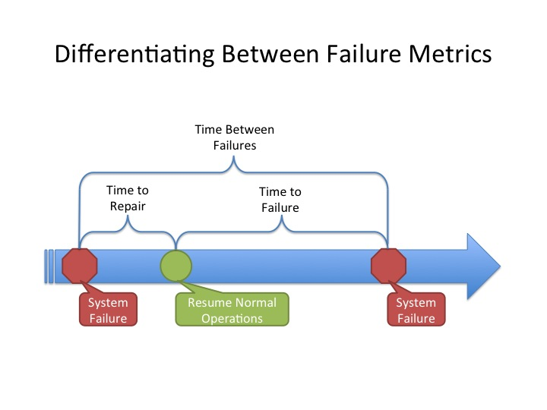
MTBF, MTTR, MTTF

Slide 23
MTBF, MTTR, MTTF
Suppose MTTR(A)=0 and MTTR(B)=0,
System A: during a 150-day period 5 failures
System B: during a 500-day period 10 failures
Questions:
What is the MTBF(A) and MTBF(B)?
What does the value mean? Which one has a higher reliability?

Slide 24
MTBF, MTTR, MTTF
Suppose MTTR(A)=5 and MTTR(B)=2,
System A: during a 150-day period 5 failures
5 days for repairing
System B: during a 500-day period 10 failures
2 days for repairing
Questions:
What is the MTTF(A) and MTTF(B)?

Slide 25
Object-Oriented Quality Metrics
Weighted Methods per Class (WMC).
Depth of Inheritance Tree (DIT).
Number of Children (NOC).
Coupling Between Object Classes (CBO).
Response for a Class (RFC).
Lack of Cohesion in Methods (LCOM).

Slide 26
Weighted Methods per Class
WMC(C) = Cm1 + Cm2 + ··· + Cmn
Cmi=complexity metrics of methods of C.
Significance: Time and effort required to understand, test, and maintain class C increases exponentially with WMC.

Slide 27
Depth of Inheritance Tree (DIT)
Distance from a derived class to the root class in the inheritance hierarchy
Measures
the degree of reuse through inheritance
the difficulty to predict the behavior of a class
costs associated with regression testing due to change impact of a parent class to descendant classes

Slide 28
High DIT Means Hard to Predict Behavior
All three classes include print()
It is difficult to determine which “print()” is used:
public static void main (...) {
Shape p; ….
p.print(); // which print()?
…
}
Shape
print()
Box
print()
Square
print()

Slide 29
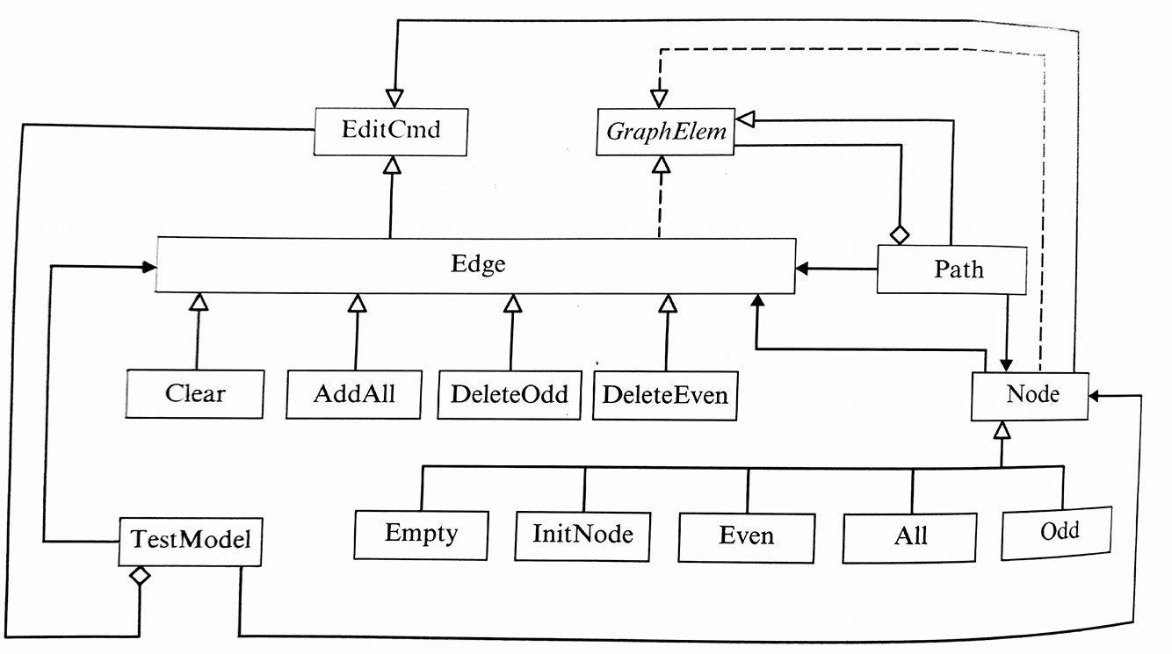
DIT = 0 : EditCmd, GraphElem, TestModel.
DIT = 1 : Edge, Path, Node
DIT = 2 : Clear, AddAll, DeleteOdd, DeleteEven, Empty, InitNode, Even, All, Odd

Slide 30
Number of Children
NOC(C)
= | { C’ : C’ is an immediate child of C }|
The dependencies of child classes on class C increases proportionally with NOC.
Increase in dependencies increases the change impact, and behavior impact of C on its child classes.
These make the program more difficult to understand, test, and maintain.

Slide 31
NOC = 0 : Empty, InitNode, Even, TestModel, etc. → Because these are the leaf nodes.
NOC = 2 : EmitCmd
NOC = 3 : GraphElem
NOC = 4 : Edge
NOC = 5 : Node

Slide 32
Bonus Time
mdc(M1)
mdc(M2)
mdc(M3)
mdc(M4)
M0
M1
M2
M3
M4
M5
M6
M7
M8
M9

Slide 33
Bonus Time
S0(M9)
S0(M8)
S0(M7)
S0(M6)
S0(M5)
S0(M4)
S0(M3)
S0(M2)
S0(M1)
M0
M1
M2
M3
M4
M5
M6
M7
M8
M9

